Slide 1
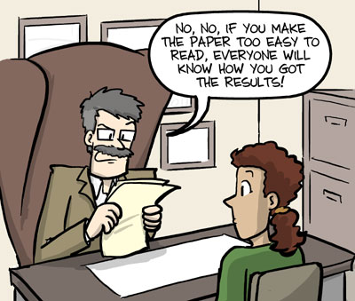
Introduction to Scientific Papers
Dr Paul Bartlett
http://www.sci.sdsu.edu/~smaloy/MicrobialGenetics/topics/scientific-writing.pdf
Notes:
‹#›

Slide 2
Biggest Problems: Lab Update
Not stapling things into Lab Books
Session Start Dates Missing
Page Numbers Missing
Equations need to be numbered and referenced
Put in Observations
Make sure your method can be followed by others
The conclusions need to have all the features shown in the guide
Students not doing eTaskbooks when they need to
Students not looking at support resources
Students rely on someone else, eventually, telling them what to do
Students not speaking to each other and making mistakes…
Time and planning…

Slide 3
Formal Reports:
A Formal Report Should Contain:
A Title Page – including name, date and abstract.
Introduction
Method
Results and Analysis
Conclusion
References
NO Appendices
IEEE Transactions on Magnetics format
4 Pages Long

Slide 4
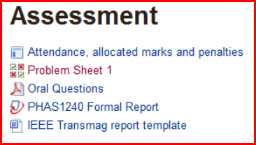
The next few sections are on general
Formal Reports issues.
However, for the fullest explanation
(and Journal requirements) use

Slide 5
Format: Flow
“Readers interpret prose more easily when it flows smoothly...
from background
to rationale
to conclusion.
Don’t force the reader to figure out your logic – clearly state the rational.
In addition, it is much easier on the reader if you explicitly state the logic behind any transitions from one idea to another.”
http://www.sci.sdsu.edu/~smaloy/MicrobialGenetics/topics/scientific-writing.pdf

Slide 6
Format: Abbreviations
Use standard abbreviations (hr, min, sec, etc) instead of writing complete words.
Define abbreviations the first time they are used, then subsequently use the abbreviation
[e.g. Britannia Royal Naval College (BRNC)].
As a general rule, do not use an abbreviation unless a term is used at least three times in the manuscript.
With two exceptions (the degree symbol and percent symbol), a space should be left between numbers and the accompanying unit.
In general, abbreviations should not be written in the plural form (e.g. 1 ml or 5 ml, not mls).
http://www.sci.sdsu.edu/~smaloy/MicrobialGenetics/topics/scientific-writing.pdf
Notes:
‹#›

Slide 7
Format: Past, Present and Future Tense
Results described in your paper should be described in past tense (you’ve done these experiments, but your results are not yet “accepted “by the scientific community).
Results from published papers should be described in the present tense (based upon the assumption that published results are “accepted”).
Only experiments that you plan to do in the future should be described in the future tense.
http://www.sci.sdsu.edu/~smaloy/MicrobialGenetics/topics/scientific-writing.pdf
Notes:
‹#›

Slide 8
Format: Past, Present and Future Tense
Third vs first person. It is OK to use first person in scientific writing, but it should be used very sparingly – reserve the use of first person for things that you want to emphasize that “you” uniquely did (i.e. not things that many others have done as well).
I don’t use ‘you’: I will reserve that for the paper that will get me the Nobel Prize.
Most text should be written in the third person to avoid sounding like an autobiographical account penned by a self-important
author.
However, it is better to say “It is possible to ..” than to say “One could ...”.
Writing that uses the impersonal pronoun ‘One’ often seems noncommittal, archaic and dry.
In addition, inanimate objects (like ‘scopes, multimeters, etc) should be described in third person
http://www.sci.sdsu.edu/~smaloy/MicrobialGenetics/topics/scientific-writing.pdf

Slide 9
Format: Empty Phrases
Avoid using phrases that do not contribute to understanding.
For example, the following phrases could be shortened (or completely deleted) without altering the meaning of a
sentence:
“the fact that ...” (delete);
“In order to ...” (shorten to simply “To ...”).
In short, don’t use more words than you need to make your point.
It is not the ‘humanities’. Channelling the spirit of a Romance Poet is not required.
In many cases you will have a limit on the size of your paper. Say what needs to be said efficiently...
Use images to help to reduce your text quantity. However, do not add images that are not used in the text. That is a waste.
http://www.sci.sdsu.edu/~smaloy/MicrobialGenetics/topics/scientific-writing.pdf

Slide 10
The next few slides are
on the sections of a report
It also shows that different Journals have slightly different styles.
We will use IEEE Transmag

Slide 11
Titles, Authors and Abstract
Make the title snappy and relevant but not frivolous
List the Authors in accordance with the publication's guidelines
The Abstract is usually the last thing you write
It is a succinct (about a paragraph) summary of the work
It should briefly encompass:
- An introduction
- the method (very brief)
- the results
the conclusions (so what test ‘passed’?)
It should ‘excite’ the reader to read MORE!
For the Formal Report we require you to follow the
IEEE Transmag formatting requirements

Slide 12

The Title, Authors and Abstract

Slide 13
The Introduction should;
describe the question tested by the experiments
described in the paper
explain why this is an interesting or important question
describe the approach used in sufficient detail that a reader who is not familiar with the technique will understand what was done and why
very briefly mention the conclusion of the paper.

Slide 14
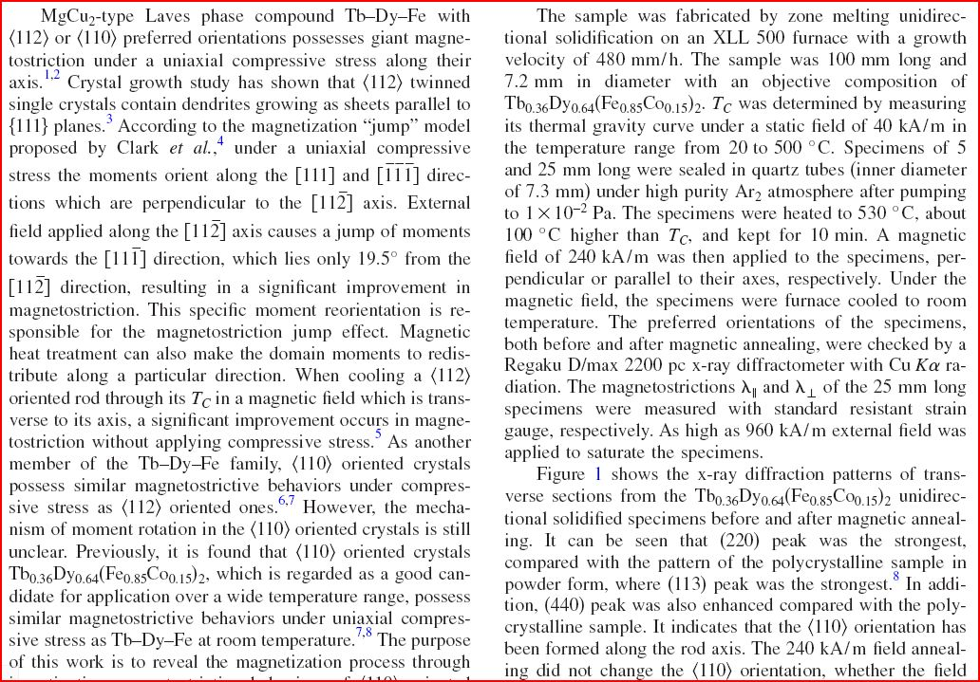
The Introduction and Method

Slide 15
The Method should;
The Method section should succinctly describe;
what was actually done
what techniques were used
any special conditions
anything of note that caused the method to be changed (especially from established procedures)

Slide 16
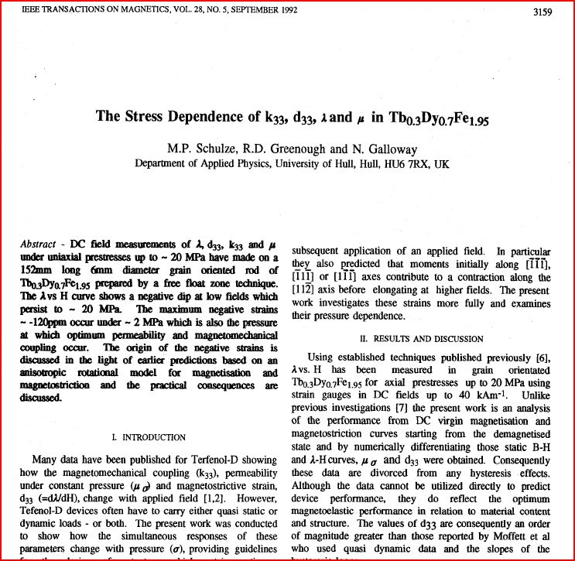

Slide 17
The Results should;
The Results section should succinctly give;
the results of the experiment
graphs and tables (where appropriate)
comments on uncertainties
initial discussion/analysis

Slide 18
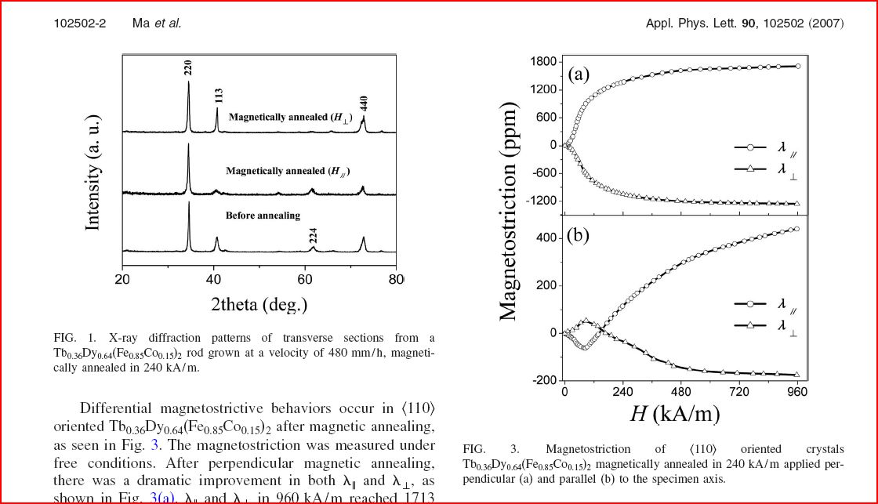
The Results and Figures...

Slide 19
The Tables and Figures;
The Tables and Figures should;
support the text (no padding)
be referenced in the text (before being shown)
Be correctly labelled with a GOOD explanatory caption
Be correctly formatted

Slide 20
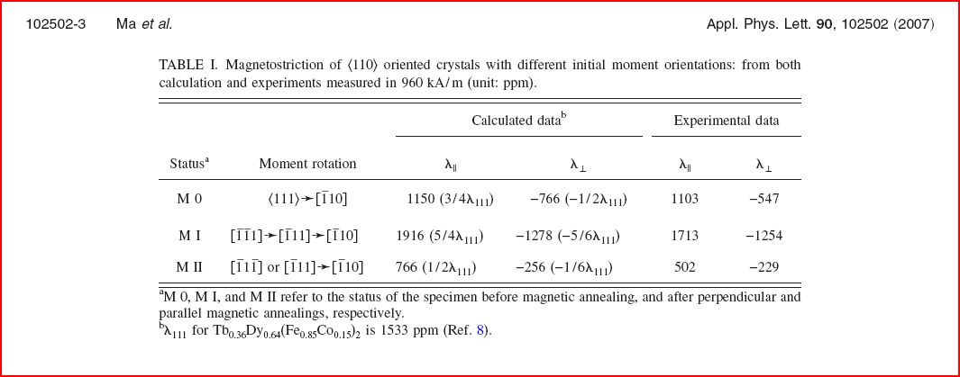
The Tables

Slide 21
The Conclusions and References;
The Conclusions should;
contain your conclusions and interpretations of the results (not just a restatement of the results; that is not enough)
state how did the results compare with what was expected (where appropriate)
Identify what further predictions can be gleaned from the results
Suggest improvements (if appropriate)
Not draw unsubstantiated conclusions
Not make cop-out statements like “..we could use computers to...”
Make the case for the ‘so what’ test...

Slide 22
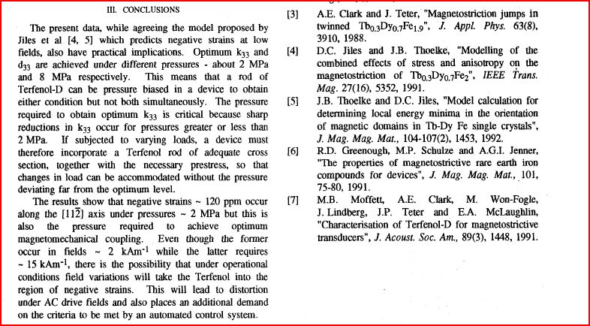
The Conclusions and References
Notes:
‹#›

Slide 23
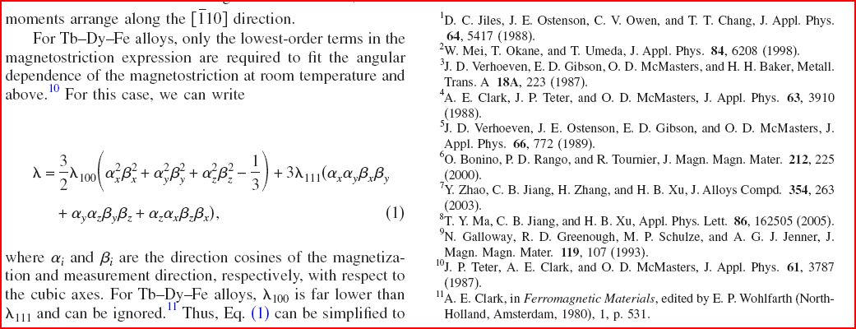
More Referencing: Equations

Slide 24
The next few sections are on
general guidance
In Moodle

Slide 25
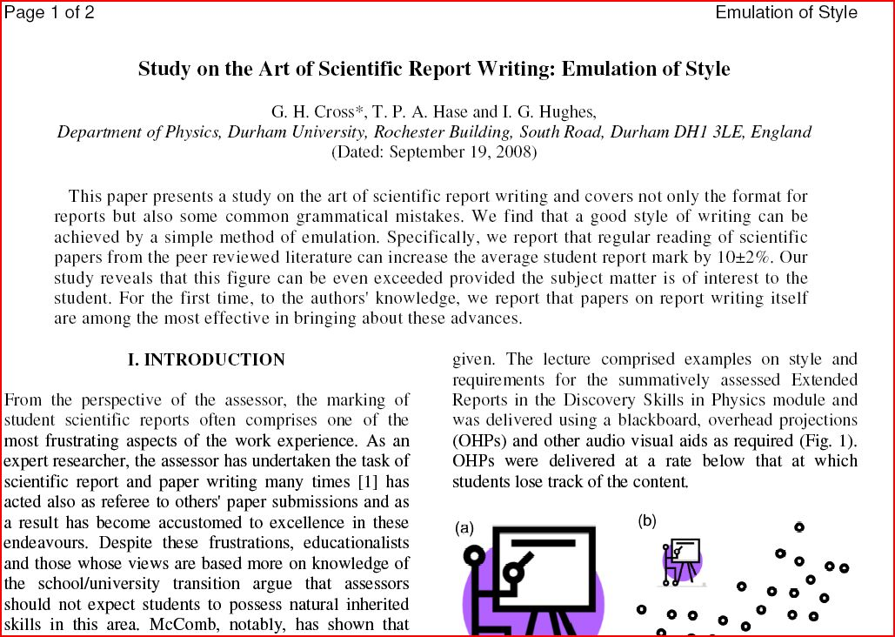
Additional Guidance
This is on the Feed Forward section of the Moodle page

Slide 26
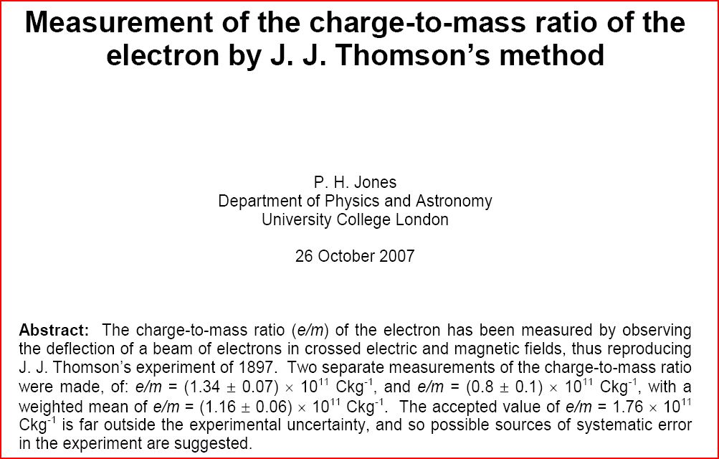
Additional Guidance
This is on the Feed Forward section of the Moodle page

Slide 27
The next few sections are on the steps and forms needed to complete the formal report

Slide 28
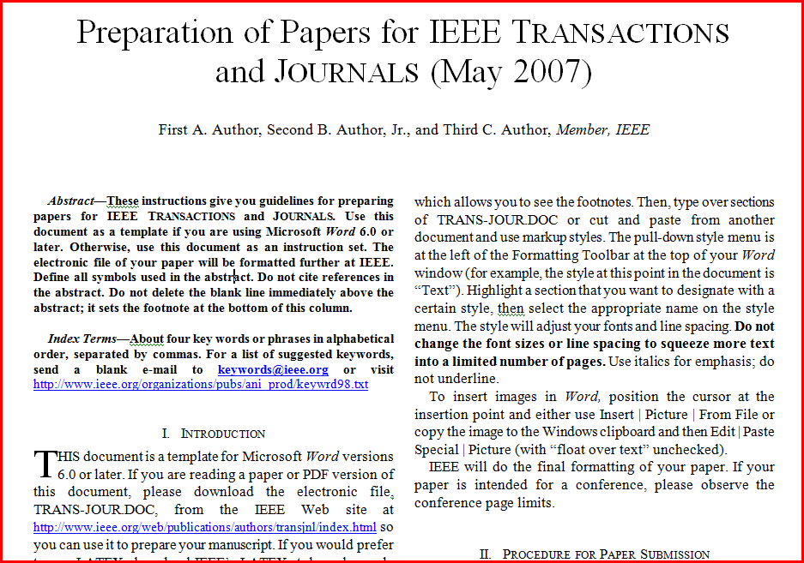
The Editable Template
This is on the Assessment section of the Moodle page

Slide 29
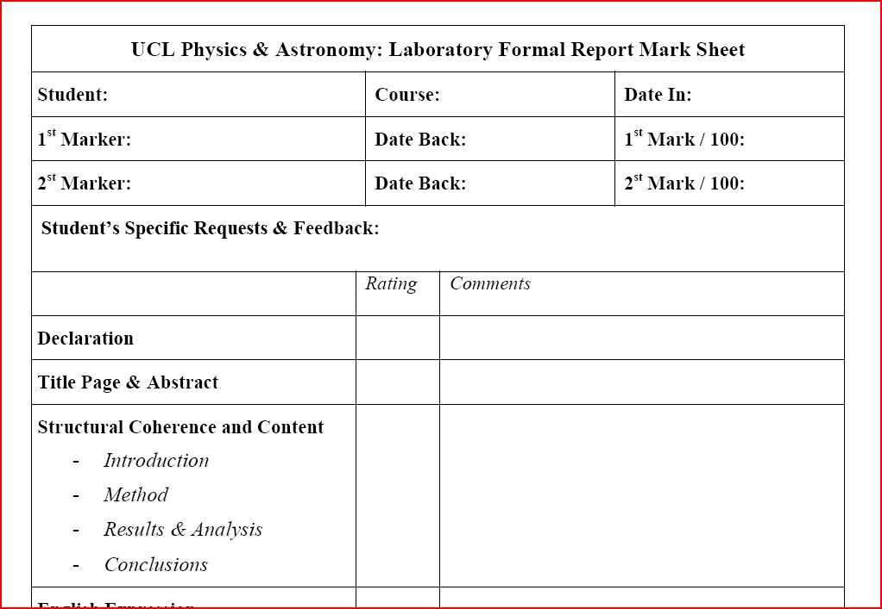
The ‘Different’ Mark Sheet
This is on the Course Resources section of the Moodle page

Slide 30
Formal Reports:
A Formal Report Should Contain:
A Title Page – including name, date and abstract.
Introduction
Method
Results and Analysis
Conclusion
References
NO Appendices
IEEE Transmag http://www.ieee.org/publications_standards/publications/authors/authors_journals.html
4 pages

Slide 31
Submit Electronically
Submit the formal report via Moodle
Submit the Declaration Sheet Electronically
More information to follow
Submit

Slide 32

Problem Sheet 2
THE COURSEWORK SHOCKER
OF THE YEAR!

Slide 33
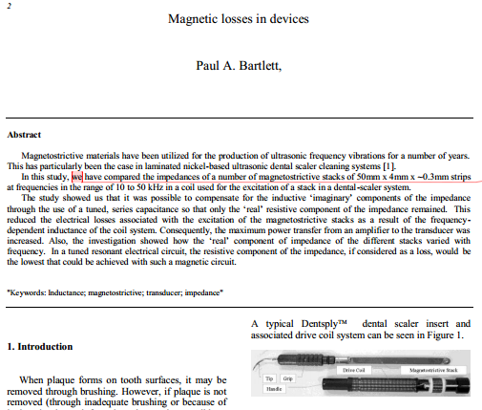
Problem Sheet 2: Quiz Assessing a flawed Scientific Paper
Click on ‘Problem Sheet 2’
Multi-Choice
Use ‘next’ to see what the questions are
Use ‘check’ to see if your answer is correct (2nd attempts are not available)
When finished, you submit your answers for marking (finish and submit)

Slide 34
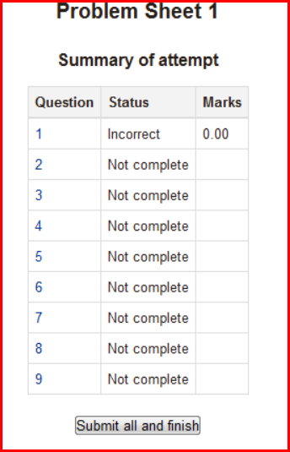
Problem Sheet 1: Quiz
Click on ‘Problem Sheet 1’
Multi-Choice
Penalties for wrong answers
Use ‘next’ to see what the questions are
Use ‘check’ to see if your answer is correct (penalty applied for mistake)
When finished, you submit your answers for marking (finish and submit)

Slide 35


Slide 36
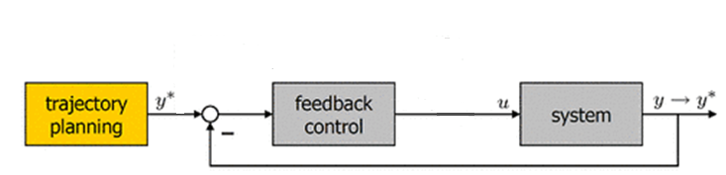
Feedback, Feedforward: Your Responsibilities
Next Experimental Write Up
Guide
Lab Book
Write Up
Verbal Feedback
Lab Book Assessment
DRT
You need to make the mistakes first:
Can waste time

Slide 37
Feedback, Feedforward: Your Responsibilities 1
Process to fix what you did wrong previously
What we want you to be able to do
What you do + ‘Errors’
Comparison between what we want you to do want what you did
You need to make the mistakes first:
Can waste time

Slide 38
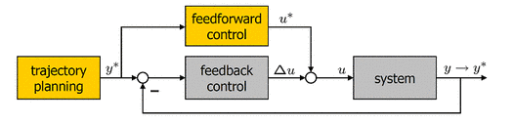
Feedback, Feedforward: Your Responsibilities 2
We tell you how NOT to make common mistakes
Comparison to eliminate common mistakes
What you do + ‘Errors’
What we want you to be able to do
Comparison between what we want you to do want what you did
Significant Reduction in Errors

Slide 39
Feedback, Feedforward: Your Responsibilities 2
W-Grades
eTaskbooks
Feedforward Resources in Moodle
Verbal Feedforward
Next Experimental Write Up
Guide
Lab Book
Write Up
Verbal Feedback
Lab Book Assessment
DRT

